Slide 1




The Impact of Interdisciplinary Relationships on Single IRB Selection in a National Clinical Trial Network
Presented by:
Kari Williams, MS*
Jacklyn Harris, MA*
Paulette Baukol, BS*
Mitra Lewis, MS
SCT 41st Annual Meeting, Baltimore (virtual) May 2020
*speakers

Slide 2

Background
In an effort to harmonize human subject research, NIH implemented a policy on the Use of a Single Institutional Review Board for Multi-Site Research. The policy went into effect on January 25, 2018 and impacts all NIH funded research. In 2019 the NIDA chose NorthStar Node to be the lead for two NIDA-CTN-funded multisite clinical trials; an implementation science study and a randomized pharmaceutical trial. Both studies span community hospitals and healthcare facilities across the country and are flagship studies for medication for opioid use disorder (MOUD) as part of the HEAL Initiative to end the national opioid public health crisis.
NOT-OD-16-094: Final NIH Policy on the Use of a Single Institutional Review Board for Multi-Site Research. (2018, January 25). Retrieved July 08, 2019, from https://grants.nih.gov/grants/guide/notice-files/NOT-OD-16-094.html

Slide 3

The National Drug Abuse Treatment Clinical Trials Network (CTN)
Provides infrastructure for rapid, multi-site trials
Links a variety of treatment providers and patient populations throughout US
The CTN framework consists of:
  16 Nodes
  Clinical Coordinating Center
  Data and Statistics Center
  Center for CTN
https://www.drugabuse.gov/about-nida/organization/cctn/ctn/network-organization
https://www.drugabuse.gov/about-nida/organization/cctn/ctn/network-organization/nodes/northstar-node

Slide 4
Objective and Methods
Select a single IRB for each flagship study (2) that was the best fit to serve the needs of multiple sites (9) across the United States.
Surveys, scored and feedback
Selection Committee
Interviews

Slide 5
sIRB Selection Process
Formed sIRB Selection Committee
Sent out sIRB survey to Nodes
Compiled list of sIRBs
Conducted interviews
Sent out follow-up survey to sIRB Selection Committee
Decided sIRB
JUNE
AUGUST
OCTOBER
JULY
SEPTEMBER
Sent out sIRB pitch to available sIRBs
Scheduled interviews
Sent out questionnaires
Analyzed results
Conducted follow up interviews
Completed Advisory Review

Slide 6
Node Survey
A survey was sent to node coordinators, principal investigators and anyone else who is involved with IRB submissions and focused on the following:
Concerns with using a single IRB
Benefits to using a single IRB
Institutional constraints to using any single IRB
Single IRB experience
Institutional preference
IRB avoidance
Open comments and feedback

Slide 7
IRB Interviews
Interview questionnaire focused on the five (5) domains:
General IRB logistics
Experience as a single IRB
Study population experience
Relevant study experience
Administrative policies

Slide 8
IRB Interview Feedback Survey
Following the IRB interviews, sIRB Selection Committee Members were asked to complete two (2) surveys, one for each study. Each of the 5 domains below was scored on a 4 point scale.
General IRB logistics
Experience as a single IRB
Study population experience
Relevant study experience
Administrative policies
Commercial IRBs A and B were selected for the final phase
Cost was not included in survey questions

Slide 9
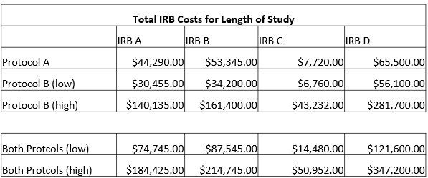
Final Selection Phase
Single IRB finalists agreed to complete an Advisory Review of the implementation study protocol
Determining factor for IRB selection
Cost was compared for both studies for IRBs A and B
Created high and low fee estimates for both studies
High estimate – considered 28 sites (4 hubs and 24 community hospitals
Low estimate – considered 4 sites (hubs)

Slide 10
Conclusion
Through the collaboration process, the Selection Committee was able to carefully compare single IRB candidates and identify benefits and challenges to working with each IRB. After more consideration and advisory review, the second choice IRB was selected for both studies.

Slide 11
Lessons Learned
Completing an advisory review of the implementation science protocol added clarity around lingering questions
Some IRBs are willing to help create an IRB budget prior to submitting your grant for approval
Creating a list of interview questions helped compare IRB qualifications between stakeholders

Slide 12
Acknowledgements
Gavin Bart, MD PhD FACP DFASAM
Eve Jelstrom, MBA

